Slide 1
Analysis of Hotel Reservation System
Present by:- Sanjana Lende
Date:-28/02/2025

Slide 2
Introduction
The hotel industry is highly competive and data driven insights are crucial for optimizing operations. In this presentation I will analyze booking trends, customer behaviour, and key performance to help hotels improve their service and revenue.

Slide 3
OBJECTIVE
- Improve customer experience
- Increase revenue through strategic pricing
- Reduce cancellations
- Enhance marketing strategies
- Understand booking trends, cancellations, and repeat customers
- Identify insights to improve hotel performance

Slide 4
DATASET OVERVIEW
Source of Data: Hospitality Reservation System dataset.(connectivity SQL to pandas)
Key Tables in Dataset:
Booking - history_id, reservation_id, status, last_updated.
Hotels – hotel_id,hotel_name,hotel_addredd.city,country,rating,total_rooms.
Reservation –reservation_id,customer_id,hotel_id,room_id,check_in,check_out,total_price,booking_date.booking_platform
Customers – customer_id,first_name,last_name,email,phone_number,address,city,country,created_at.Gender
Rooms - room type, price per night, availability, price_per_night.

Slide 5
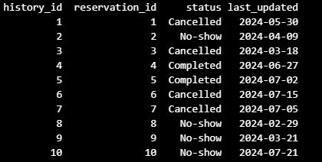
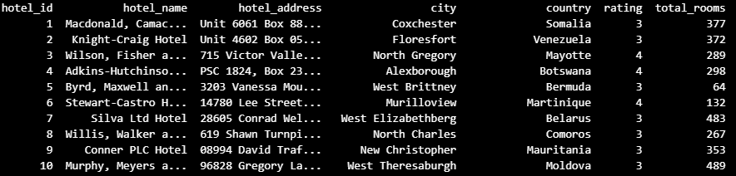
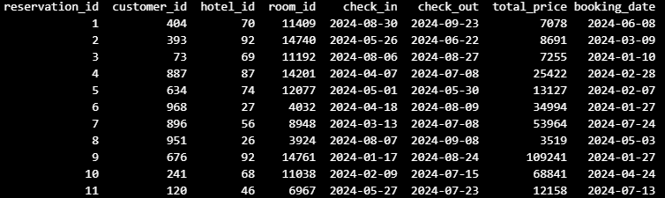
TABLE OVERVIEW

Slide 6
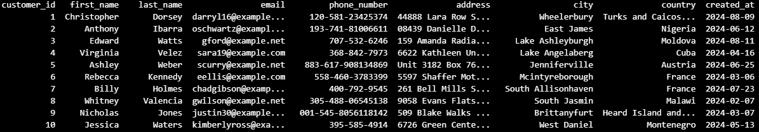
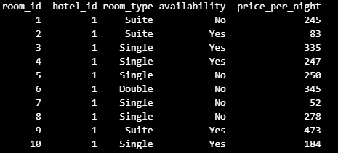
TABLE OVERVIEW

Slide 7
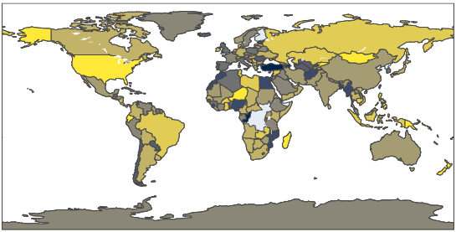
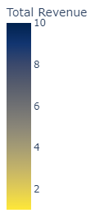
Global Financial
CONCLUSION:
Turkey generated the highest revenue, indicating a strong market presence or high transaction volume.
SUGGESTIONS:
Countries with lower revenue may indicate untapped opportunities for business expansion or marketing efforts.

Slide 8
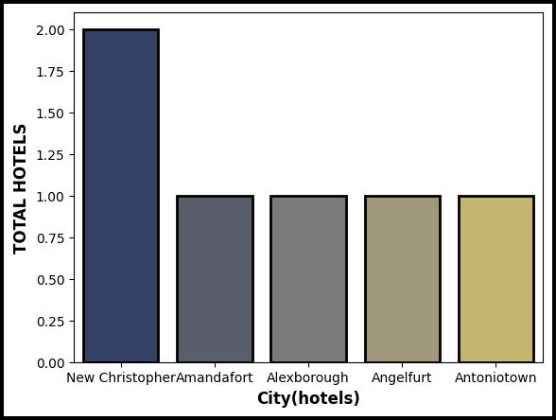
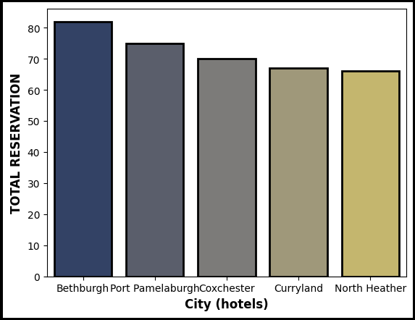
Analysis of Hotel Availability vs Reservations
CONCLUSION:
SUGGESTIONS:
The Comparison between number of hotels and reservations in the top 5 cities revels that having a large number of hotels does not always guarantee the highest number of reservations
Optimize Hotel Occupancy : Cities with high hotel availability but lower reservations should focus on better marketing strategies, promotions to attract more travels

Slide 9
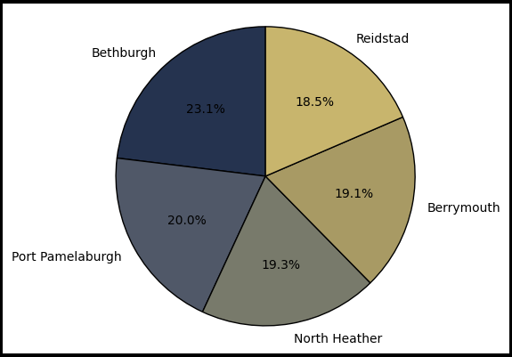
Global Reservation & Revenue Trends
CONCLUSION:
The data reveals that citys with the highest number of reservations do not necessarily generate the most revenue. This indicates variations in pricing, spending behavior, and market dynamics across different regions.
SUGGESTIONS:
Revenue Optimization: Citys with high reservations but low revenue could explore premium services, upselling, or dynamic pricing models to increase profitability.

Slide 10
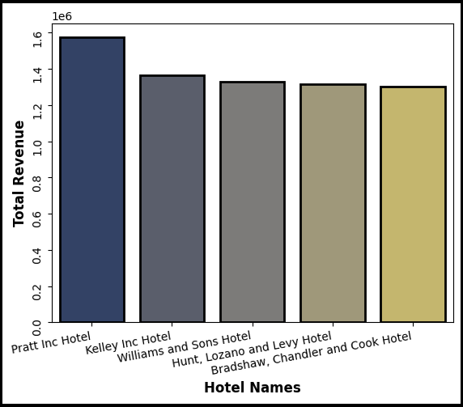
Revenue Leaders: Analyzing the Top-Performing Hotel
CONCLUSION:
Pratt Inc. Hotel generated the highest revenue, highlighting its strong customer demand and business performance.

Slide 11
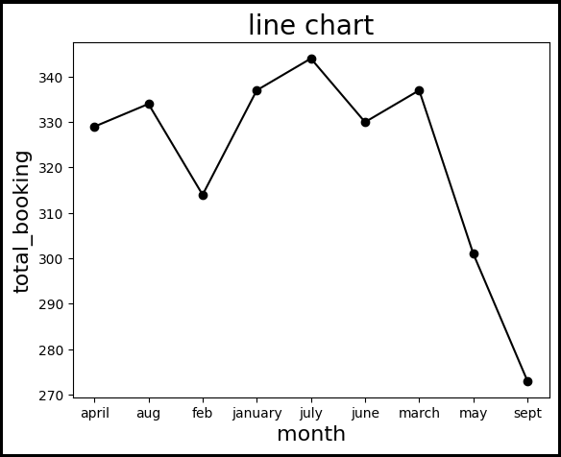
Seasonal Booking Trends
CONCLUSION:
The highest number of bookings occur in July, indicating a peak travel season, likely due to summer vacations.
SUGGESTIONS:
Boost Occupancy in Low Months (September, May, February)
Marketing Strategies

Slide 12
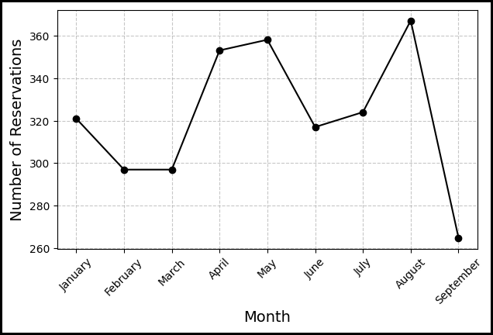
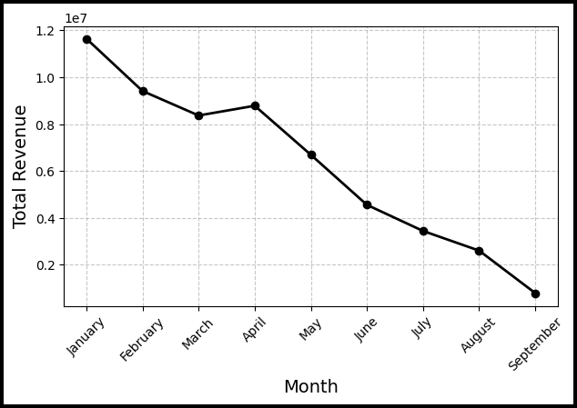
Insights for Strategic Growth"
CONCLUSION:
January generating the highest revenue, followed by February and March. This indicates that although reservations were lower in these months, higher pricing or premium bookings contributed to increased revenue.
SUGGESTIONS:
January–March generates high revenue despite lower reservations, it may be due to higher pricing or premium services.
Focus promotional efforts on lower-performing months like September to boost both reservations and revenue.

Slide 13
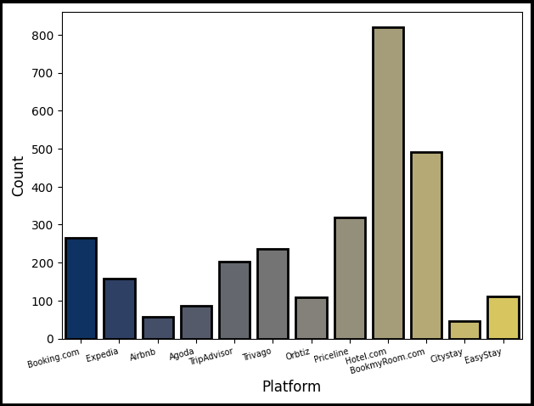
Battle of Bookings: Analyzing Platform Usage Trends"
CONCLUSION:
Hotel.com is the most-used booking platform, indicating strong customer trust, better deals, or superior user experience
The preference for Hotel.com suggests better marketing strategies, partnerships with top hotels, or a smoother booking process..
SUGGESTIONS:
Increase partnerships with popular and high-rated hotels
Invest in digital marketing, social media ads, and partnerships with hotels..
Improving website/app UX,

Slide 14
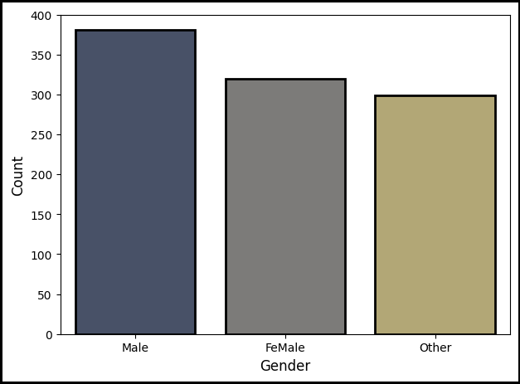
Gender Distribution
CONCLUSION:
Female customers rank second, showing a significant market presence but slightly lower engagement.
SUGGESTIONS:
Targeted Marketing for Female & Other Genders – Personalize offers and advertisements to attract a diverse audience
Enhance User Experience – Ensure the booking process is seamless and welcoming for all demographics.

Slide 15
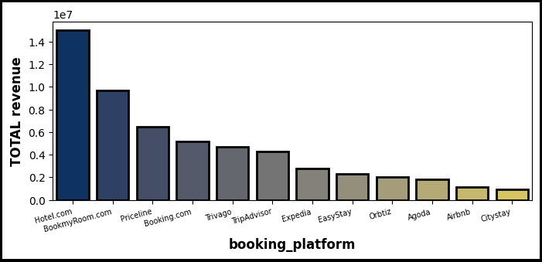
Booking Platform Revenue Insights"
CONCLUSION:
Hotel.com is the leading booking platform, driving the highest number of revenue.
BookMyRoom.com ranks second, indicating strong competition and customer preference for online hotel bookings.
SUGGESTIONS:
Other platforms may analyze pricing, customer experience, and promotions to improve their market share.

Slide 16
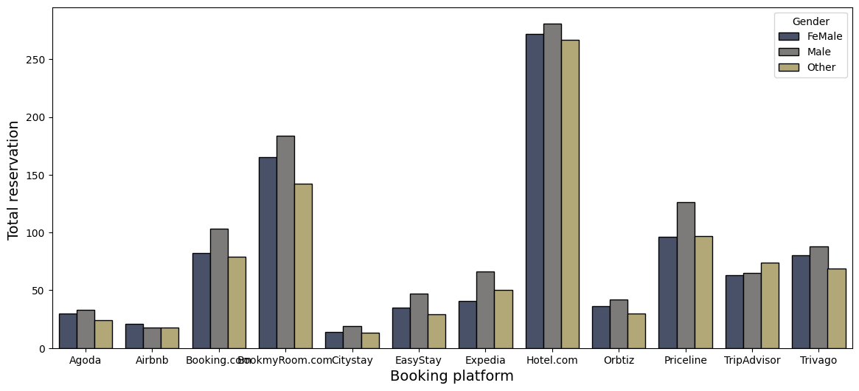
Platform Power: Analyzing the Impact on Reservations .
CONCLUSION:
The analysis of platform power and its impact on reservations, considering category and gender usage, reveals a competitive landscape where Hotels.com holds the leading position, followed by Book My Room and Priceline.

Slide 17
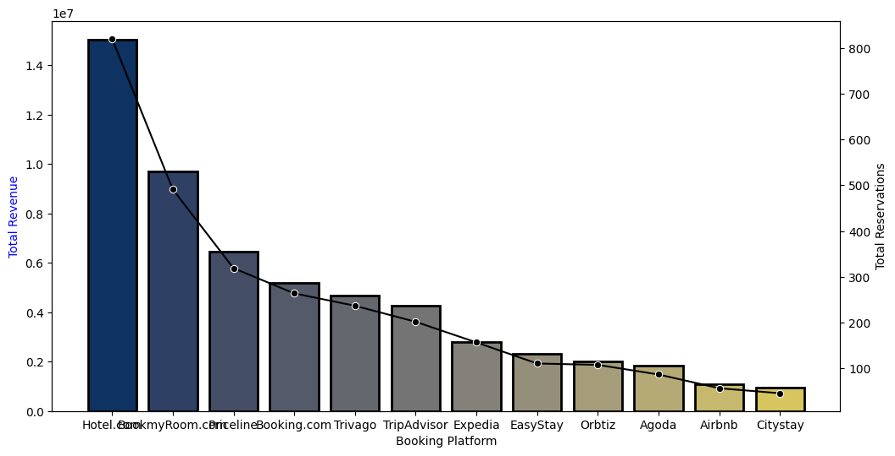
Decoding Platform Influence
CONCLUSION:
SUGGESTIONS:
Hotels.com has successfully implemented strong revenue-generating strategies, such as competitive pricing, effective marketing, loyalty programs, and exclusive partnerships with hotel
Optimize Conversion Rates: Improving website/app UX, reducing booking friction, and providing seamless payment options can increase successful reservations.

Slide 18
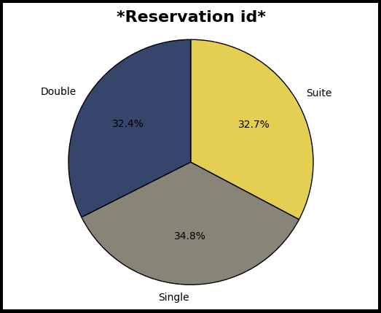
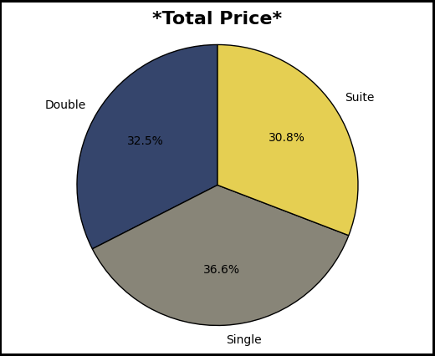
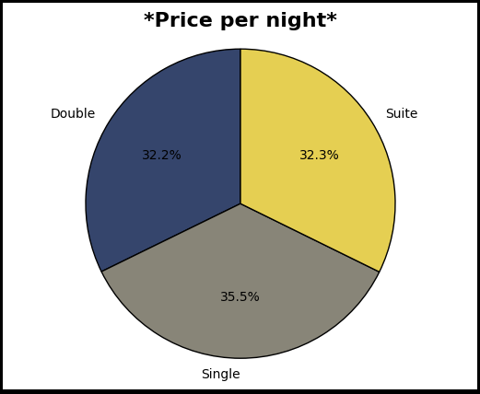
ROOM TYPE ANALYSIS
CONCLUSION:
SUGGESTIONS:
The single rooms outperform other room types in reservations, revenue, and price per night, showing they are well-positioned in the market. Suites, while moderately demanded, are underpriced compared to their potential. Double rooms require strategic improvements to increase their demand and profitability
To optimize performance, the hotel should sustain the pricing strategy for single rooms, adjust suite pricing to capture higher revenue, and promote double rooms to increase reservations and improve their overall contribution

Slide 19
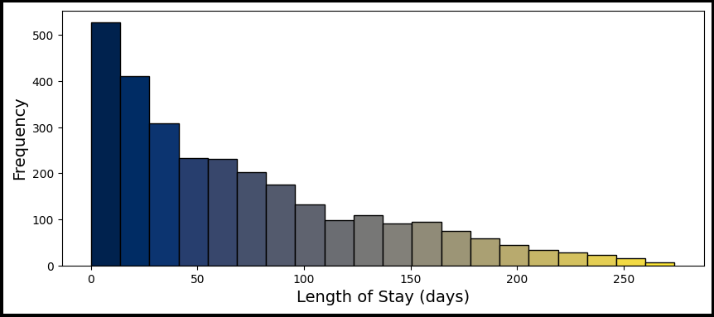
Understanding Guest Stay Patterns
CONCLUSION:
SUGGESTIONS:
1.Most customers tend to stay for short durations (0–50 days)
2.The number of customers decreases significantly as the length of stay increases beyond 50 days.
3.Very few customers stay for over 200 days.
1.Short-Term Packages:Since the majority of customers prefer short stays, design attractive short-stay packages or offers to enhance customer engagement and satisfaction.
2. Long-Term Promotions:To attract long-stay customers, consider introducing discounted long-term plans, loyalty rewards, or corporate tie-ups to increase revenue.

Slide 20
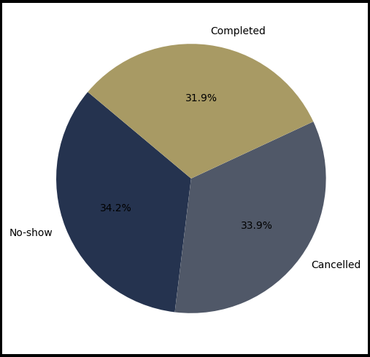
Impact of cancellations on business.
CONCLUSION:
SUGGESTIONS:
This indicates that a significant portion of business operations is being affected by cancellations and no-shows, which collectively account for over 68% of the total transactions.
This negatively impacts revenue, resource allocation, and overall efficiency.
Improve Cancellation Policies: Introduce stricter cancellation rules or penalties to reduce last-minute cancellations.
Address No Shows: Implement reminders via email, SMS, or calls to reduce forgetfulness
Charge a nominal fee for no-shows to recover lost revenue
Provide incentives like discounts or loyalty points for completed bookings to encourage attendance.

Slide 21
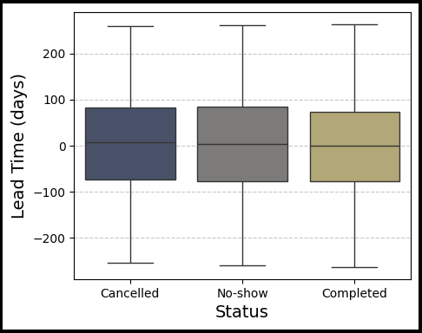
Analyzing Cancellation Time
CONCLUSION:
SUGGESTIONS:
Customers who book well in advance tend to cancel or not show up more frequently.
Completed bookings have a relatively stable distribution, with fewer extreme cases.
Negative lead times could indicate late modifications, system errors, or last-minute bookings that need further investigation.
Offer early cancellation discounts or penalties for last-minute cancellations to reduce revenue loss.
Investigate data inconsistencies and refine the booking system to prevent negative values.
Send reminders to guests with long lead times to reduce cancellations.

Slide 22
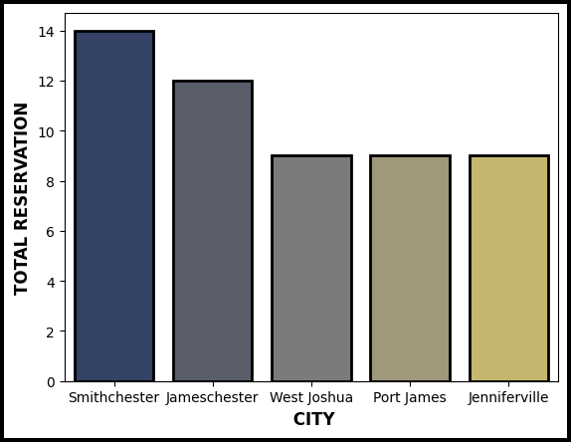
"Understanding Guest Demographics:
CONCLUSION:
The analysis of customer addresses shows that the highest number of customers come from Smithchester, followed by Jameschester in second place. The next three cities—West Joshua, Port James, and Jenniferville—have the same number of customers, creating a tie.
SUGGESTIONS:
Invest in top-ranked cities for higher business potential
Understand the Tied Cities

Slide 23
Conclusion & Recommendations
- Hotels can optimize pricing based on booking trends
- Understanding customer behavior helps in targeted marketing
- Reducing cancellations can significantly improve revenue
- Data-driven insights enhance operational efficiency

Slide 24
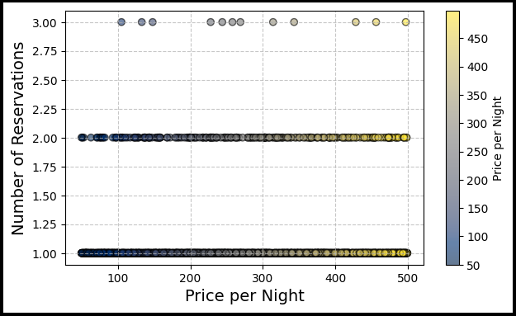
The Influence of Room Pricing on Booking Trends"
CONCLUSION:
Most rooms have either 1,2,or 3 reservations ,meaning customers don’t frequently book the same room many times.
The distribution of reservations is quite flat, meaning there’s no clear trend that higher-priced or lower -priced rooms get more reservation
SUGGESTIONS:
If business wants more reservations, they might consider discounts or promotions for mid-priced rooms.
Additional factors like room type and location might affect reservations more than just price.

Slide 25
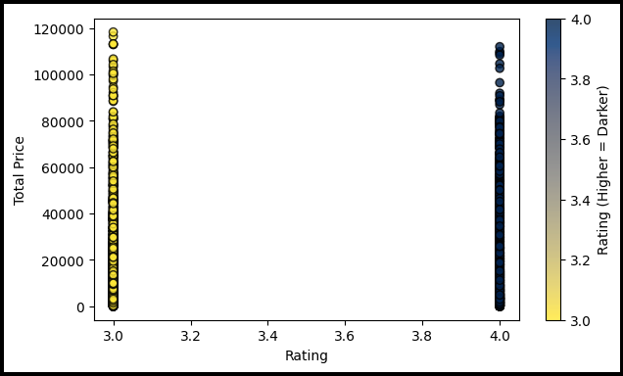
Insights on price and satisfaction
CONCLUSION:
SUGGESTIONS:
1.Customer Satisfaction (Ratings):Services with higher ratings (3.8 - 4.0) tend to have higher prices, meaning customers prefer premium services.
2. Lower Ratings: Services with lower ratings (3.0 - 3.5) have lower prices, which may indicate a need for improvement.
Business Strategy: Improving service quality to achieve higher ratings could allow for increased pricing and greater revenue generation.

